Slide 1


Slide 2
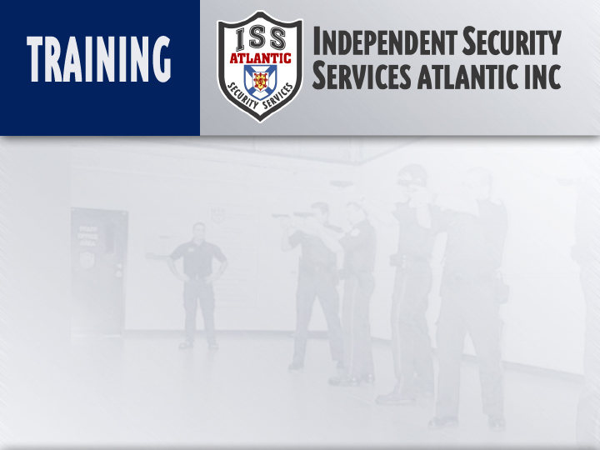
TACTICAL GROUND FIGHTING
Instructor:
Date

Slide 3
Topic: Tactical Ground Fighting
Objectives:
  To discuss the force context of this module
  To explain the concept of fulcrum / momentum
  To introduce the weapons of the body
  To introduce the targets of the body
  To introduce the concepts of ground fighting

Slide 4
Method Of Instruction:
Lecture development,
Practical exercises,
Written exam
Training Aides:
Presentation, Mats, Exam
Pen and paper are required

Slide 5

INTRODUCTION
Many physical confrontations end up on the ground.
Offenders will often attempt to ground their victims.
However finding yourself on the ground can be an advantage
Your back, hips, and shoulders have a base and are balanced
Strategic factors associated to ground fighting are;
maximum defensive capabilities,
conservation of energy,
extremely effective and practical offence,
excellent field of vision.

Slide 6
INTRODUCTION
Tactical Ground Fighting is also a viable technique for defense against spontaneous knife attacks.
As the defender drops into a tactical position, vital body parts are away from any edged weapons the subject may have.
The most exposed body parts are the feet and shins.

Slide 7
INTRODUCTION
However, many see being on the ground as a disadvantage.
Common perceived disadvantages are:
    Lack of power
    Lack of options
    Limited mobility
    Lack of ability (they think their opponent is better trained)
    Fear

Slide 8
POINT TO REMEMBER
Everything that you learn today will be concepts only. We will show you the basics, but it is important to remember that in this type of force encounter anything goes.
You should always think win, and you will come out on top.

Slide 9
LECTURE OVERVIEW
Force Justification.
Fulcrum/Momentum Concept.
Targets of the Body.
Weapons of the Body.

Slide 10
FORCE JUSTIFICATION
Due to the fact that you are on your back on the ground, it is now considered to be a lethal force encounter.
Therefore you are justified in using lethal force to counter.
These encounters are considered lethal force because;
Any downward blows from the subject could be life threatening. The energy from their force has nowhere to go but into the ground, giving you no way to retreat from the force.

Slide 11
FULCRUM / MOMENTUM CONCEPT
Fulcrum
    Is the PIVOTAL POINT in which leverage is applied against.
Momentum
    Is the FORCE used to propel one object over the stationary object.

Slide 12
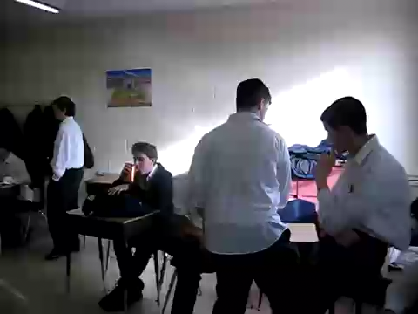

Slide 13
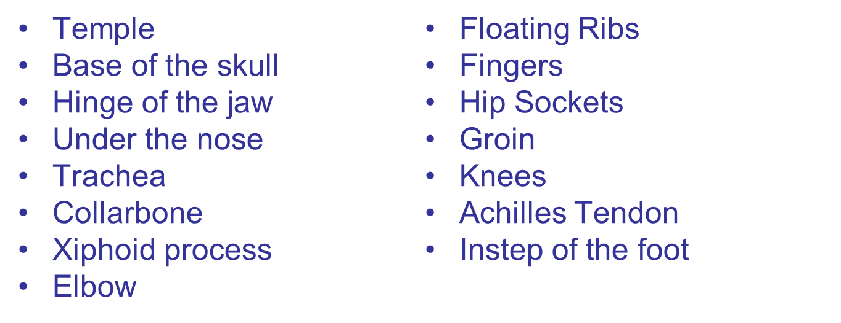
TARGETS OF THE BODY
NOTE: Less lethal targets – Common Peroneal, Tibial, Femoral, Radial, Median, and Brachial Plexus.

Slide 14
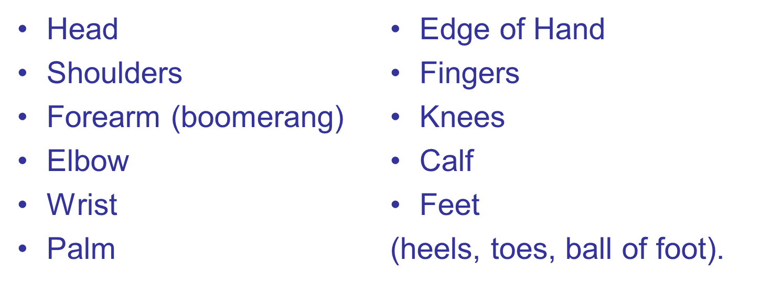
WEAPONS OF THE BODY

Slide 15
PRACTICAL SESSION
GROUND FIGHTING POSITION.
FALLING.
DROPPING.
REDIRECTION.
KICKS.

Slide 16
5 Minute break and then lets meet upstairs!

